Slide 1
The Writing Process
Week 1

Slide 2
Writing Process
Writing is a process that is done through a series of stages:
Each stage is essential.
Prewriting
Writing (Drafting)
Revising
Editing & Proofreading

Slide 3
I. Prewriting
Choose a topic to write on
narrow your topic
Determine your
Purpose
Tone
Tense
Focus in on central ideas
Explore your topic
Brainstorm or generate ideas for your topic
Make a plan

Slide 4
 | How to narrow down a topic
Aspect | Select one perspective/aspect and use it for viewing a problem. For example, instead of studying the different factors that cause cancer, study how smoking can cause lung cancer.
Components/ Elements | Figure out the type or category. For example, a topic on tobacco use among teenagers can be narrowed down to chewing tobacco instead of all forms of tobacco use or teenagers in general.
Place | analyzing a smaller geographical unit means a narrow topical focus. For example, instead of studying trade relations in Asia, focus on trade relations between China and Singapore guide you in explaining problems in that region.
Time | adding a time frame narrows the topic . For example, instead of studying trade relations between China and Singapore, focus on the trade relations between China and Singapore between 2010 and 2018.

Slide 5
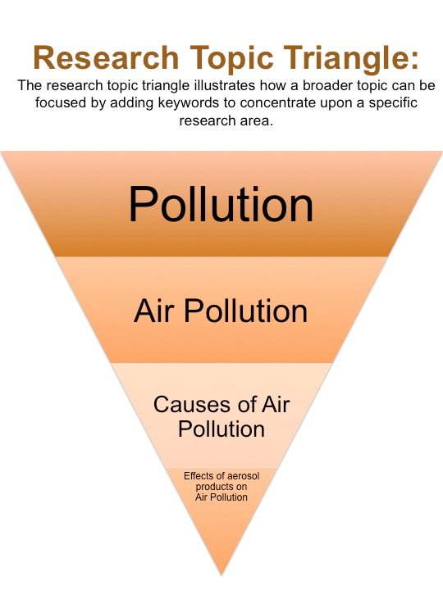
Narrow Down Your Topic
Your topic should pass the 3-question test:
Does it interest me?
Do I have something to say about it?
Is it specific?

Slide 6
EDUCATION
________________________________
________________________________
________________________________
Practice Topics
1. Culture
2. Festivals
3. Environment
4. Happiness

Slide 7
Explore Your Topic
Narrowing down
Free writing
Brainstorming
Listing
Clustering
Outlining
Pre-writing Techniques
Notes:
Pre-writing is an informal process that allows you to explore ideas as they occur to you.
There are five main strategies for getting started on any writing assignment:
1. Free-writing
2. Brainstorming
3. Listing
4. Clustering
5. Outlining

Slide 8
Free-Writing
Freewriting is just what it says—writing freely
whatever comes into your mind, even before researching about it
Does not require complete sentences, proper spelling, or correct punctuation and grammar
About 10 to 15 minutes to write everything that comes to mind even if it doesn’t necessarily make sense yet.
Free Writing

Slide 9
Example of Free Writing
Describe your room in detail.
My room? Hmm, it's nothing too fancy, just a cozy corner of our house in Lahore. Light floods in through big windows, making everything seem warm. The wooden furniture — solid and a bit rustic — reminds me of those old family homes. I’ve added some plants too, you know? Just a few, but they make the space feel so fresh. I can sit for hours on the comfy couch, lost in a book or sipping chai. There's a calmness here, especially when the sunlight hits just right, almost like time slows down. Feels like a little retreat from the bustling world outside.

Slide 10
Practice
Free write for 5 minutes on the following topic:
What is the most frightening experience you have ever had?

Slide 11
Brainstorming
“Brainstorming” means thinking of as many ideas as possible in a short amount of time.
Write down your ideas so that you don’t forget them.
There is no sequence of ideas
Write down everything that comes to your mind; don’t worry about sorting out “good” and “bad” ideas.

Slide 12
Brainstorming
is creating a list of ideas in response to a problem or question.
ideas generated by brainstorming don’t need to be related to each other; they only need to be related to the problem at hand.
Two main ways of brainstorming:
Posing and answering questions about a problem or topic: Who? What? Where? When? Why? How?
Gathering a list of ideas related to the problem or topic.
Brainstorming

Slide 13
Example of Brainstorming
What would I do with one million dollars?
Travel--Europe, Asia, S. America
Pay off our house
Share--give a scholarship, donate to charities
Buy a lot of books!
Invest/save and let the interest grow

Slide 14
Topics for Practice
Take 5 minutes to brainstorm ideas about the following question:
What are some of the most memorable experiences of your life?

Slide 15
Listing
Listing is a process of generating a lot of information within a short time by generating some broad ideas and then building on those associations for more detail.
Jot down all the possible terms that emerge from the general topic you are working on.
Listing works well for descriptive-type writing.
Simply write down as many possibilities as you can.
Note: do not write single words rather write a phrase/clause covering only 1 idea in each point

Slide 16
Example of Listing
Describe your favorite room in the house/apartment where you live.
the large windows filling the room with natural light
Soft, plush carpets covers the floor
A cozy corner sofa sits against the wall
Decorative throw pillows in vibrant
an artfully arranged bookshelf in the corner
The room is painted in soothing neutral tones
A large rug anchors the seating area
House plants are scattered around
the soft glow from the floor lamp
A small coffee table holds candles and magazines

Slide 17
Clustering
Clustering utilizes a visual map to shape ideas and explore how those ideas relate to each other.
Clustering is another way to record your thoughts and observations for writing a paragraph or essay

Slide 18
Clustering
When you cluster, your topic goes in a bubble in the middle of the page. From there, your ideas expand to form a spider-web visual.
How to do it?
1. First, in a circle near the center of the page, write out the subject of your essay or paragraph.
2. Then write down other ideas that relate to your central ideas -- use lines and circles to "map" how the different aspects of your topic will relate to each other.

Slide 19
Example of Clustering
Never stop learning
Instill a love of education in my children
education
Eventually get a PhD
Learn to love whatever work I am doing
My future
Make them a priority
Stay at home while raising children
family
work
Use the skills I have learned in as many ways as possible
Stay close to my husband
Raise healthy, happy children

Slide 20
Outlining
Outlining is a good way to organize your ideas. It's best to use an outline after you've done some free-writing, listing or clustering.
It's also good to use an outline after you've written the first draft to help you organize your paragraphs and sentences.
Especially for long papers, outlines can be quite detailed, but even a short outline can be helpful in giving the writer ideas and a sense of organization for an essay.

Slide 21
Example of Outlining
I. Introduction: Internet “friendship” has advantages and disadvantages.
II. Advantages
a) meet people around the world
b) not based on appearance
III. Disadvantages
a) can you trust them?
b) may be too far away to meet in person
IV. Conclusion: Some success stories, but too risky

Slide 22
Writing your Thesis Statement
A thesis statement generally consists of two parts:
your topic, and the main point: the analysis, explanation(s), or assertion(s) that you are
making about the topic.
OR
Thesis statement = Narrowed topic + main point
Euthanasia is suicidal, it should be banned.
Narrowed topic main point
Example

Slide 23
A 3-point thesis statement is a coherent statement that integrates the three essential components of a standard thesis statement.
includes a topic, an assertion, and reasons justifying the claim.
Thesis statement = Narrowed topic + Main point + First supporting reason/idea + Second supporting reason/idea + Third supporting reason/idea
Three Point Thesis Statement
Example

Slide 24
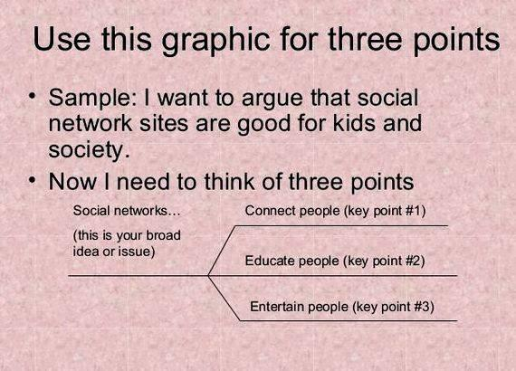

Slide 25
Practice
Writing Prompt:
Should students be allowed to eat snacks in the classroom? Why or why not?
Thesis Statement:
Students (should / should not) be allowed to eat snacks in the classroom because
______, _________, and ________.
Writing Prompt:
2. Write an essay explaining why a decision you made was the right one?
Thesis Statement:
My decision to______________ was the right one because___________,
___________, and ____________.

Slide 26
Practice
Instructions: Read the points and write a three point thesis statement.
Topic: Young people should pay attention to politics.
Young people are intelligent enough to understand what’s going on.
Politics affects everyone’s lives, including young people’s.
Paying attention to politics now will help young people to be informed citizens when they are old enough to vote.
3-Point Thesis
Statement

Slide 27
II. Drafting - Putting your ideas and thoughts together in sentences and paragraphs.
organize all of your notes from your pre-writing into separate paragraphs.
The paragraphs should support your introduction and your thesis statement.
Everything needs to flow smoothly.
The conclusion, or "end", of your essay should sum up what you have said, without repeating. It should give the reader some final thoughts on the topic you are writing about.
III. Revising is rewriting or rearranging sentences to make sense.
making decisions about how you want to improve your writing
looking at your writing from a different point of view
picking places where your writing could be clearer, more interesting, more informative and more convincing.

